Slide 1

ECG Classification with ML
31. JULY 2023.
Uroš Pantelić i maša Đurić

Slide 2

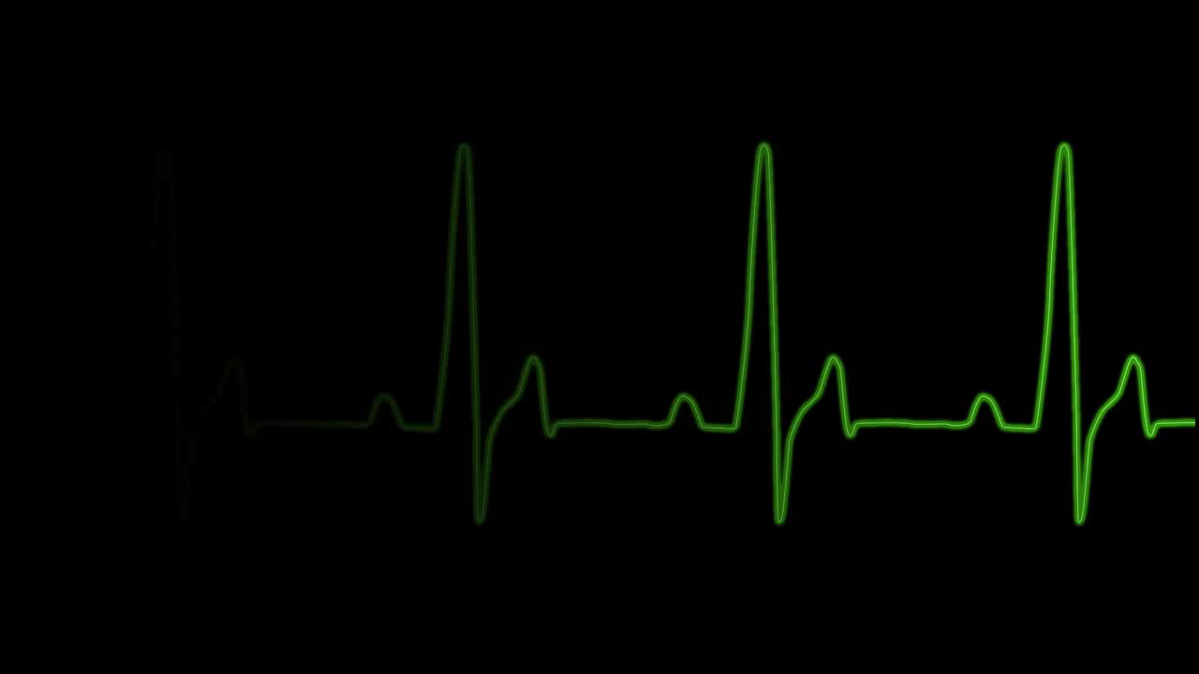
Introduction
ECG Signal Classification using Deep Learning
The main goal of this project is to develop a deep learning model that can classify ECG signals into different diagnostic categories.

Slide 3
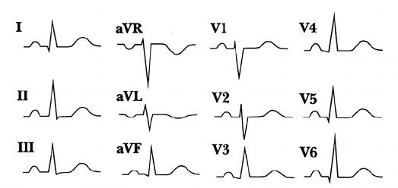
Dataset Overview ECG Signal Classification using Deep Learning
PTB-XL ECG dataset
Dataset contains ECG data from 18,869 patients
Each patient's ECG recording includes 12 leads, providing a wealth of cardiac electrical activity information.

Slide 4
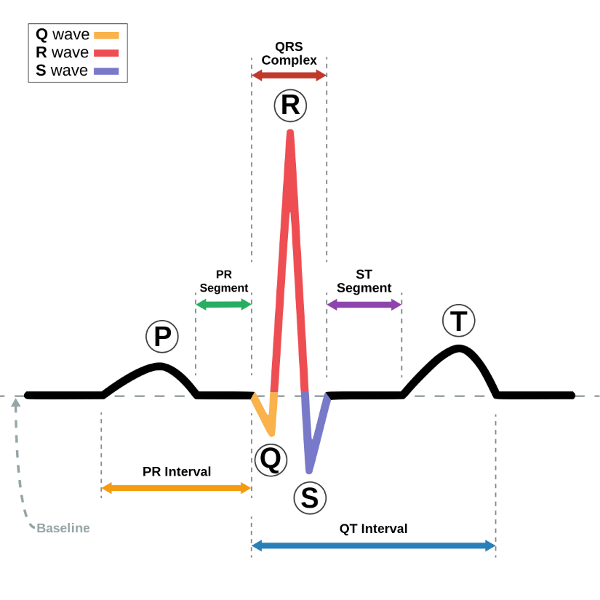
Dataset Overview
ECG Signal Classification using Deep Learning
#Records | Superclass | Description
9514 | NORM | Normal ECG
5469 | MI | Myocardial Infarction
5235 | STTC | ST/T Change
4898 | CD | Conduction Disturbance
2649 | HYP | Hypertrophy

Slide 5
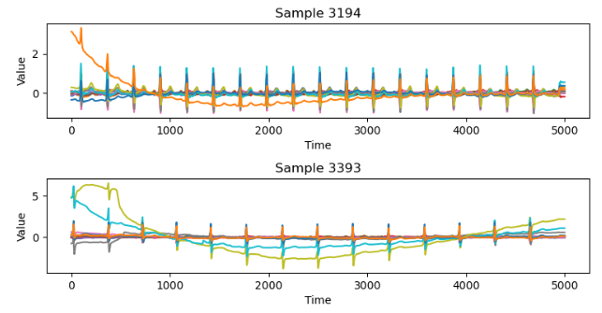
Data Preprocessing ECG Signal Classification using Deep Learning
Data Cleaning
Identifying and handling outliers, which are data points that significantly deviate from the rest of the data.
Addressing various issues introduced by machines, such as baseline drift, burst noise, electrodes problems

Slide 6
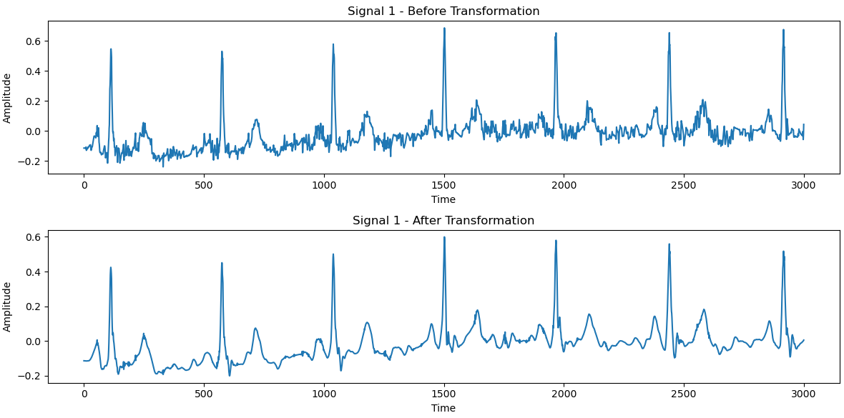
Data Preprocessing ECG Signal Classification using Deep Learning
Discrete Wavelet Transform
We used DWT for denoising signals, extracting both low and high-frequency components to effectively remove noise and enhance signal quality.

Slide 7
Data Preprocessing ECG Signal Classification using Deep Learning
Stratification
Stratification involves splitting the dataset into subsets (e.g., training and testing sets) while maintaining the same class distribution as the original dataset. This is particularly important when dealing with imbalanced datasets, as it ensures that both the training and testing sets have a representative proportion of samples from each class.
| train / val ------ |----------- CD | 3346 / 365 HYP | 1732 / 194 MI | 3788 / 411 NORM | 7342 / 791 STTC | 3579 / 392

Slide 8
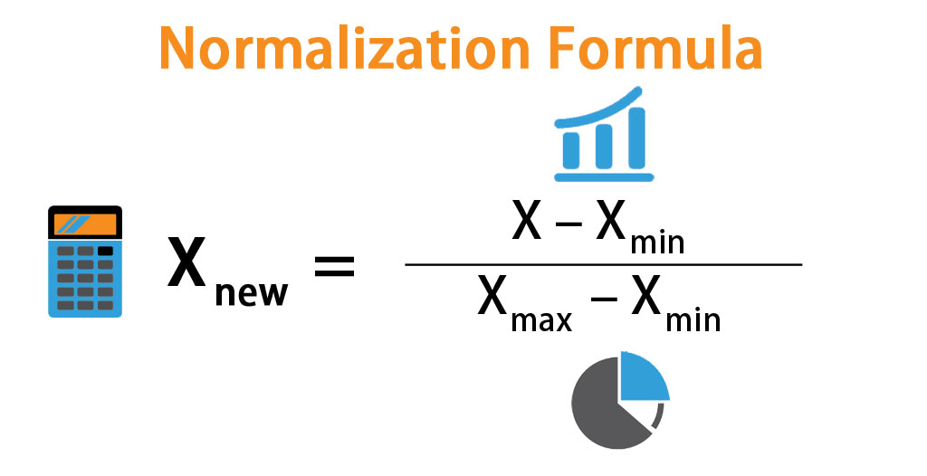
Data Preprocessing ECG Signal Classification using Deep Learning
Data Normalization
The signals were normalized to ensure consistent scaling.

Slide 9
Data Preprocessing ECG Signal Classification using Deep Learning
Data Augmentation
To increase the robustness of our model, we applied random noise to the signals
magnitude warp
rescale
static noise
dividing each signal into smaller segments, we effectively create more samples, which can help improve the model's generalization and performance by providing it with diverse variations of the original data.
Data cropping
The purpose of data trimming is to eliminate any potential artifacts or transient effects at the beginning and end of the dataset

Slide 10

Data Preprocessing ECG Signal Classification using Deep Learning
Oversampling
Oversampling is a technique used to address class imbalance in a dataset, where one or more classes have significantly fewer samples compared to other classes.
Class Weighting
Class weighting is a technique used to modify the learning process of a classifier by assigning different weights to different classes. The purpose is to give higher importance to the minority class (less frequent class) and lower importance to the majority class (more frequent class) during the model's training phase

Slide 11
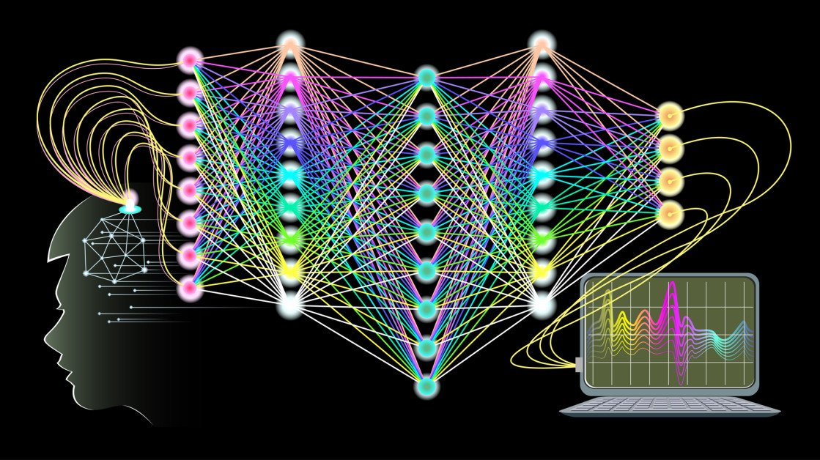
CNN1D: The 1D Convolutional Neural Network (CNN1D)
CNN2D: The 2D Convolutional Neural Network (CNN2D)
RNN with LSTM: The Recurrent Neural Network (RNN) model with Long Short-Term Memory (LSTM)
Model Architecture - SimpleCNN ECG Signal Classification using Deep Learning

Slide 12
Model Architecture – Results ECG Signal Classification using Deep Learning
Conv1D,Conv2D,LSTM, five classes at once ​
68%training
60% validation​
Best: Conv1D, one class at the time
85% accuracy on test

Slide 13
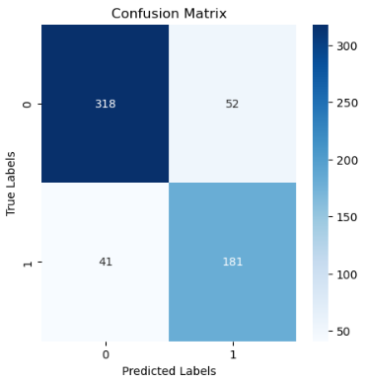
Model Architecture – Confusion Matrix ECG Signal Classification using Deep Learning
epochs=30
learn_rate=0.00005
Batch=4

Slide 14

Questions?

